Slide 1
Usability Heuristics & GUI Proposal
By Vignesh
Notes:
After analysing the previous batch’s prototype for their conformance to usability heuristics, I extrapolated the following findings.

Slide 2
GUI Proposal
Notes:
With that I’ll now present my GUI proposal.

Slide 3
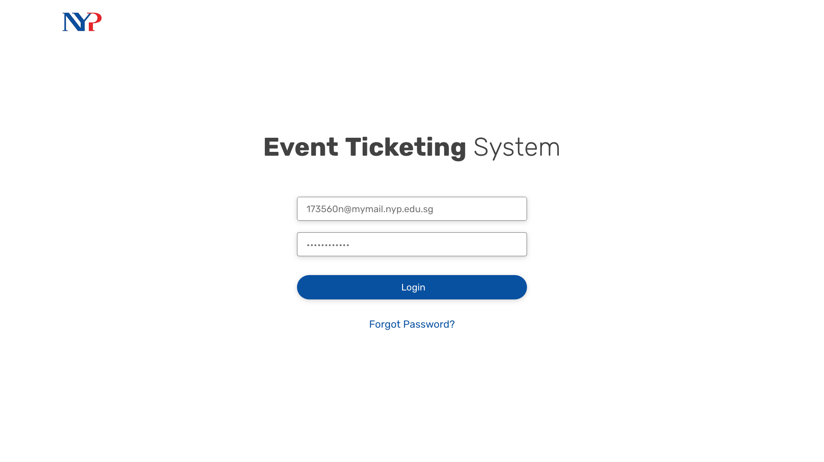
Notes:
We start with the login screen (nothing remarkable)
We might not even have a login screen depending on whether Oauth might work for our project
Anyway, a student will now login to the system.

Slide 4
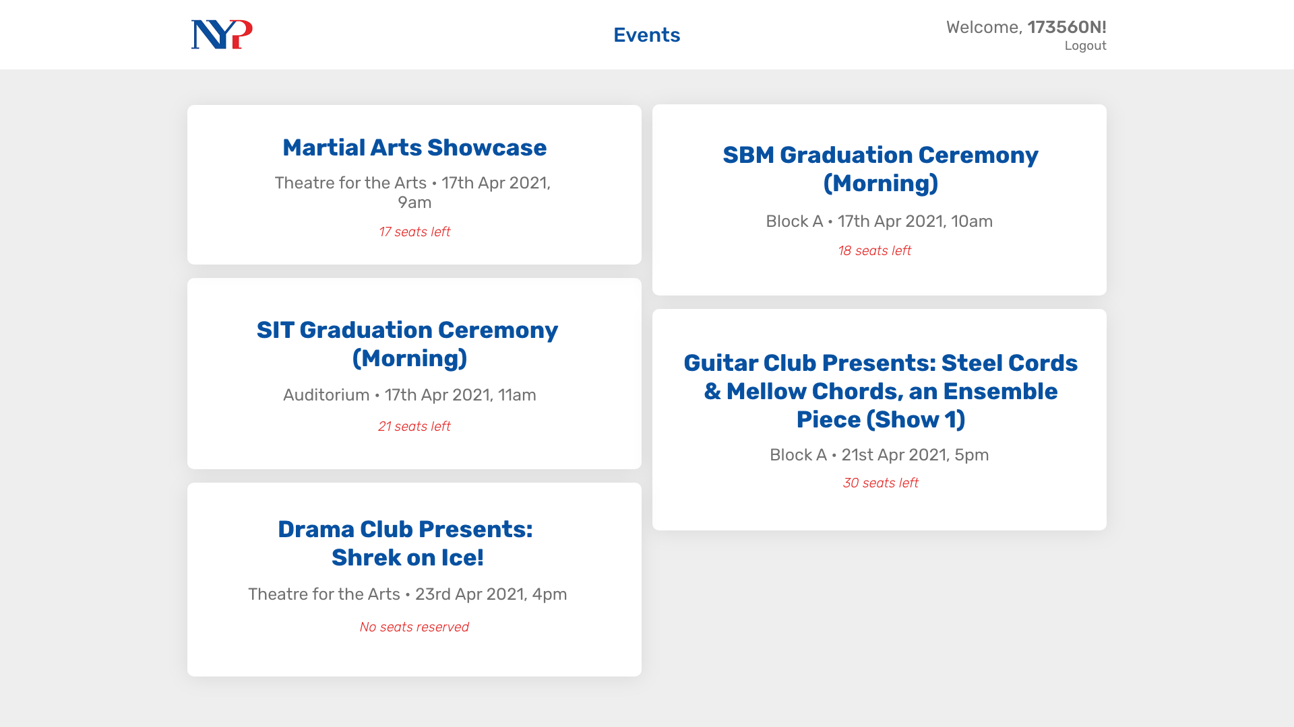
Notes:
Upon entering, they’re presented with this screen where they can view events they are helping with in a more visually appealing manner.
Once they click on one of these event cards, they can view more details.

Slide 5
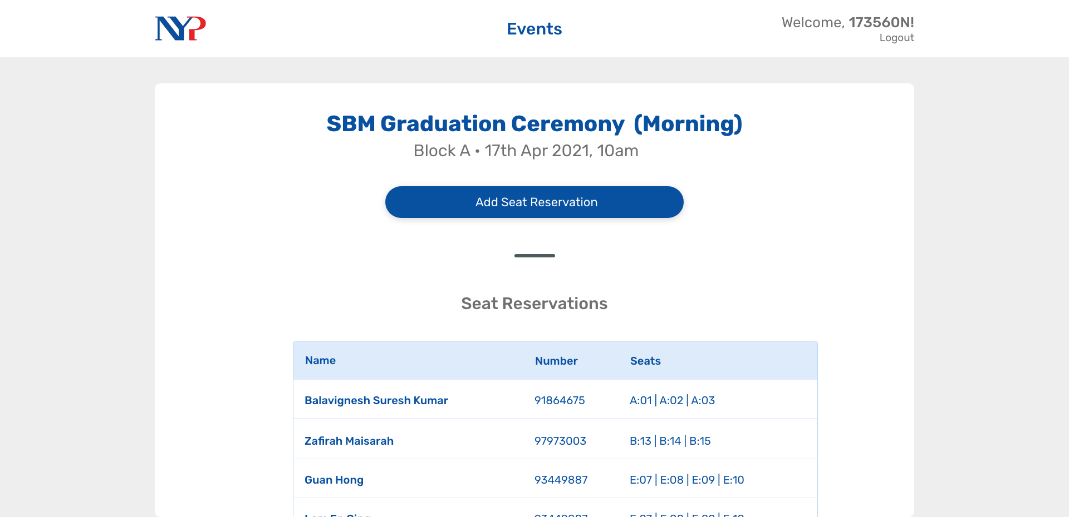
Notes:
So here, they can see the seats that are already reserved in a table form.
They can then choose to reserve a new set of seats by pressing the button.

Slide 6
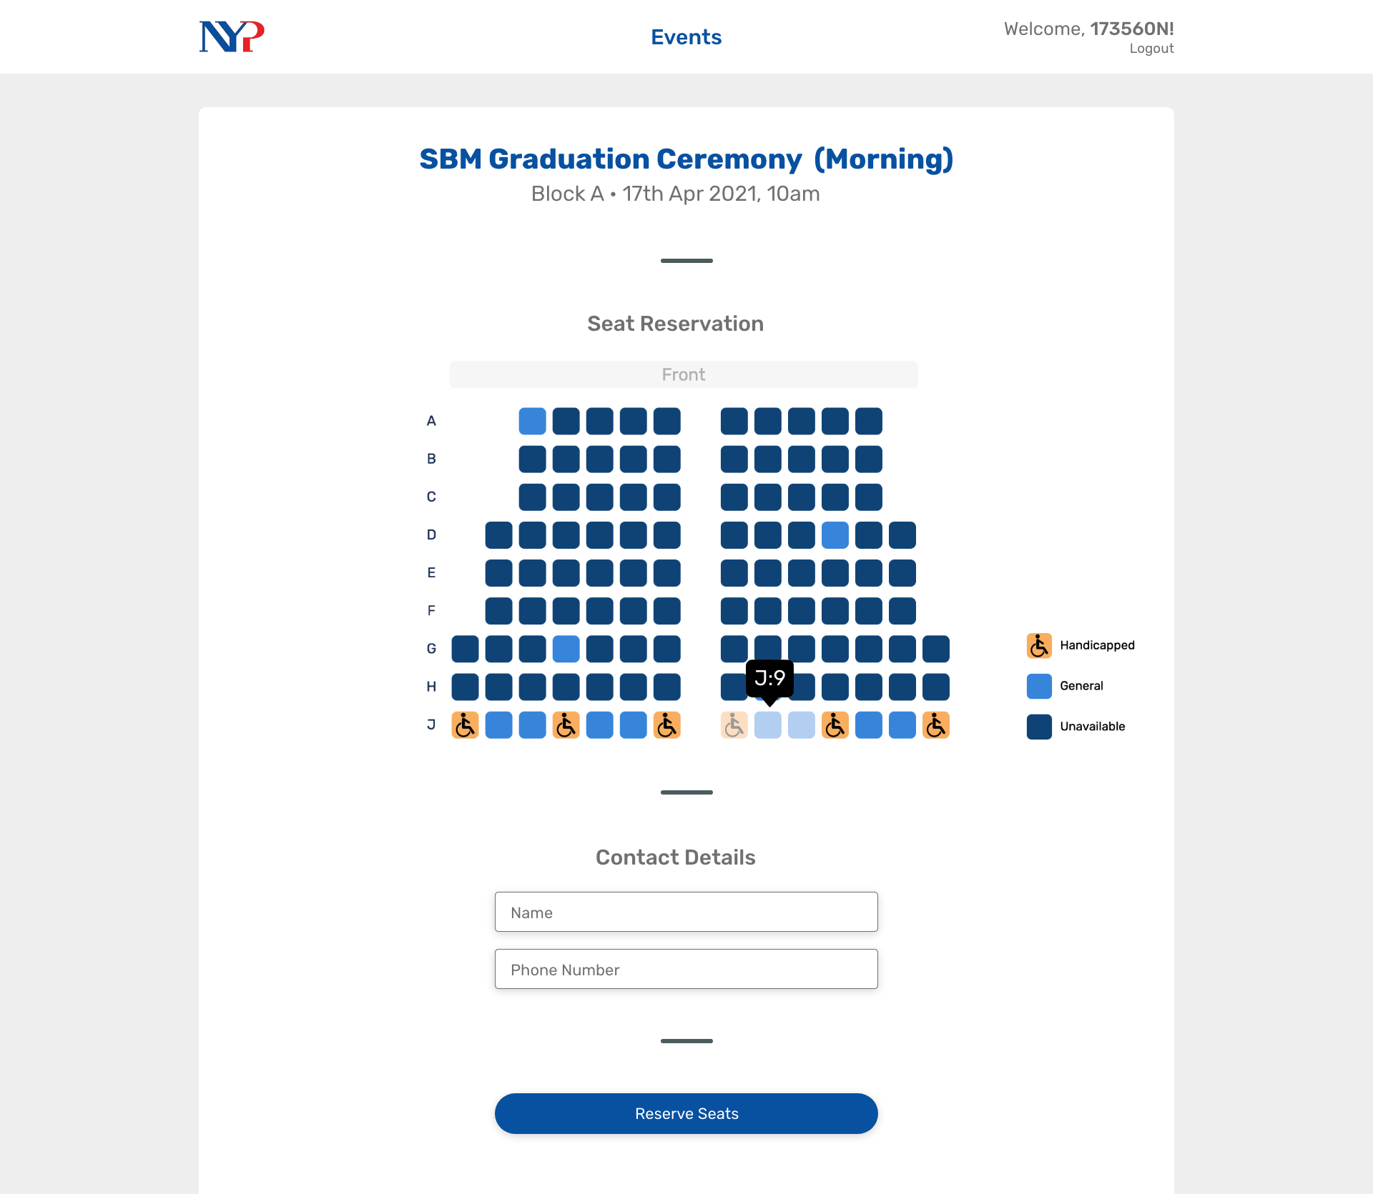
Notes:
over here, i'm using a functional seat chart to show the student helper all the seats that are available in a more visual manner. they can then select the seats they deem fit for the attendees.
after doing so they just have to enter the contact details to send them their tickets via SMS
warn student helper when not booking seats according to criteria (top -> down)
block seats at event creation
able to change handicapped seats for each event
add more validation

Slide 7
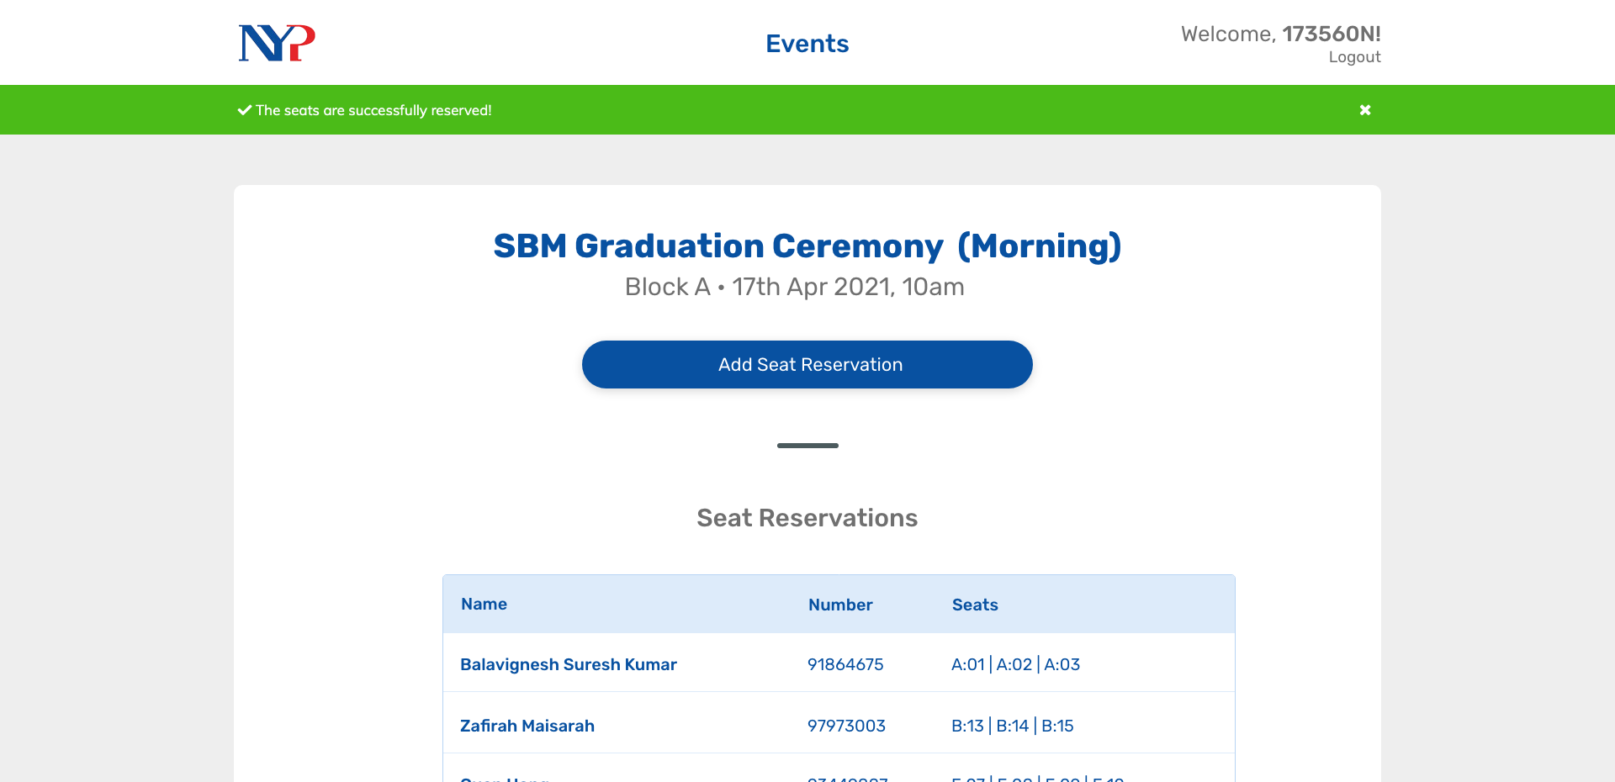
Notes:
And after this process is done, they

Slide 8
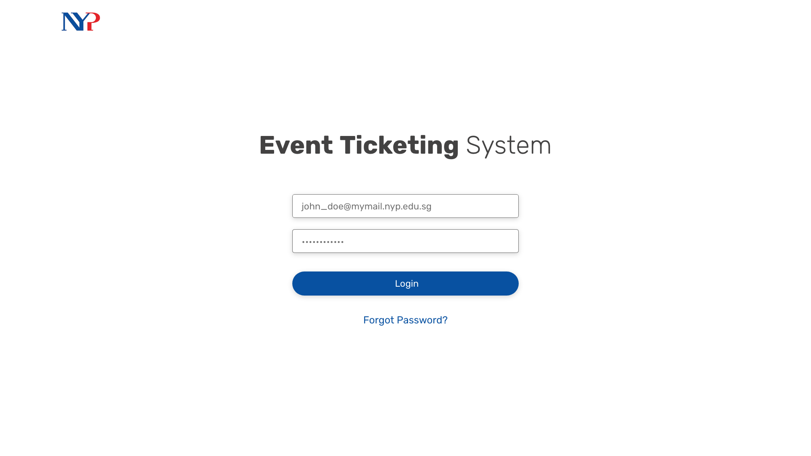

Slide 9
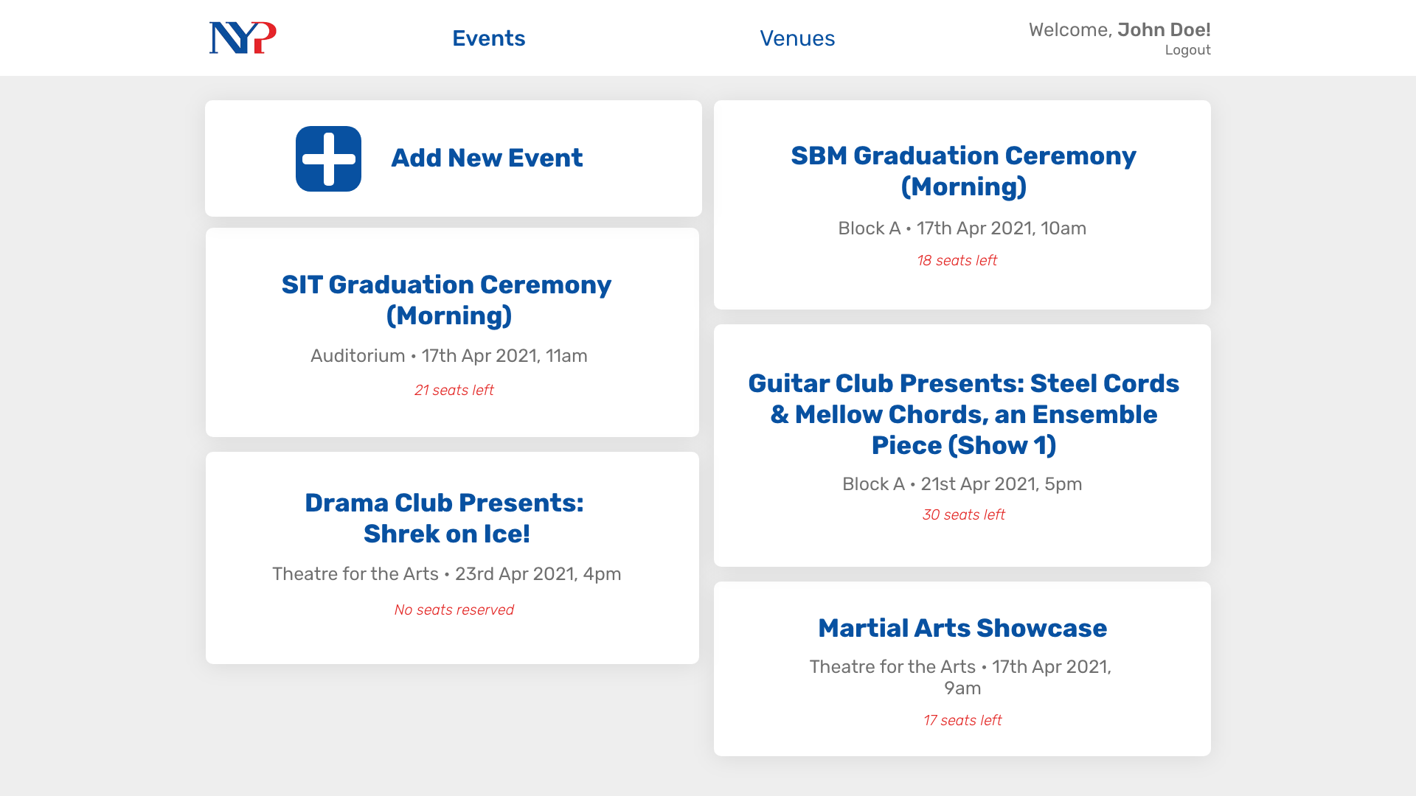

Slide 10
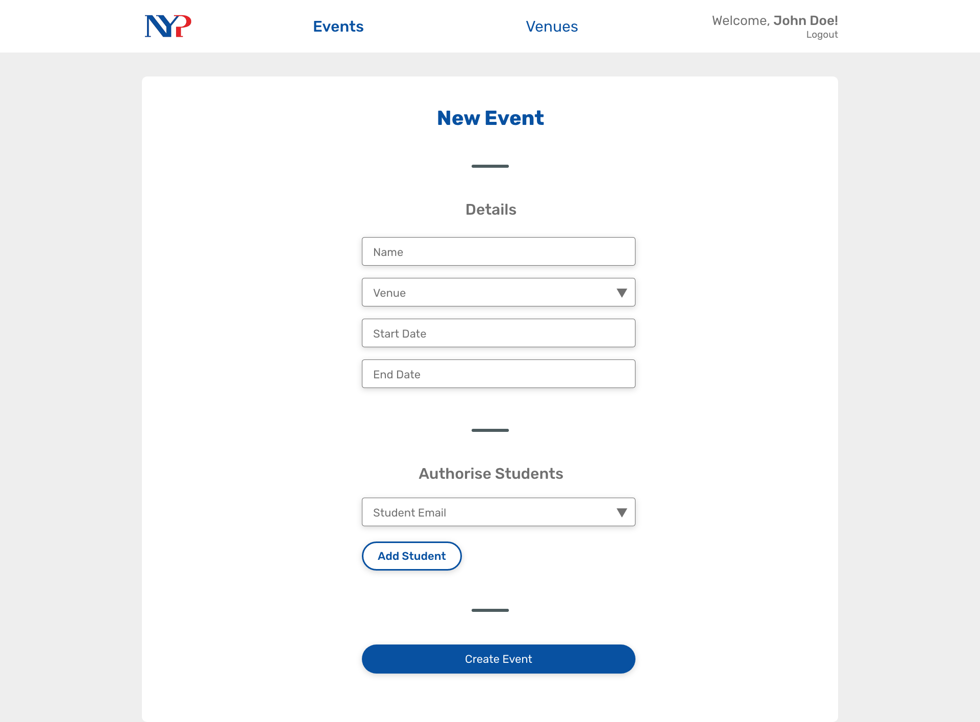

Slide 11
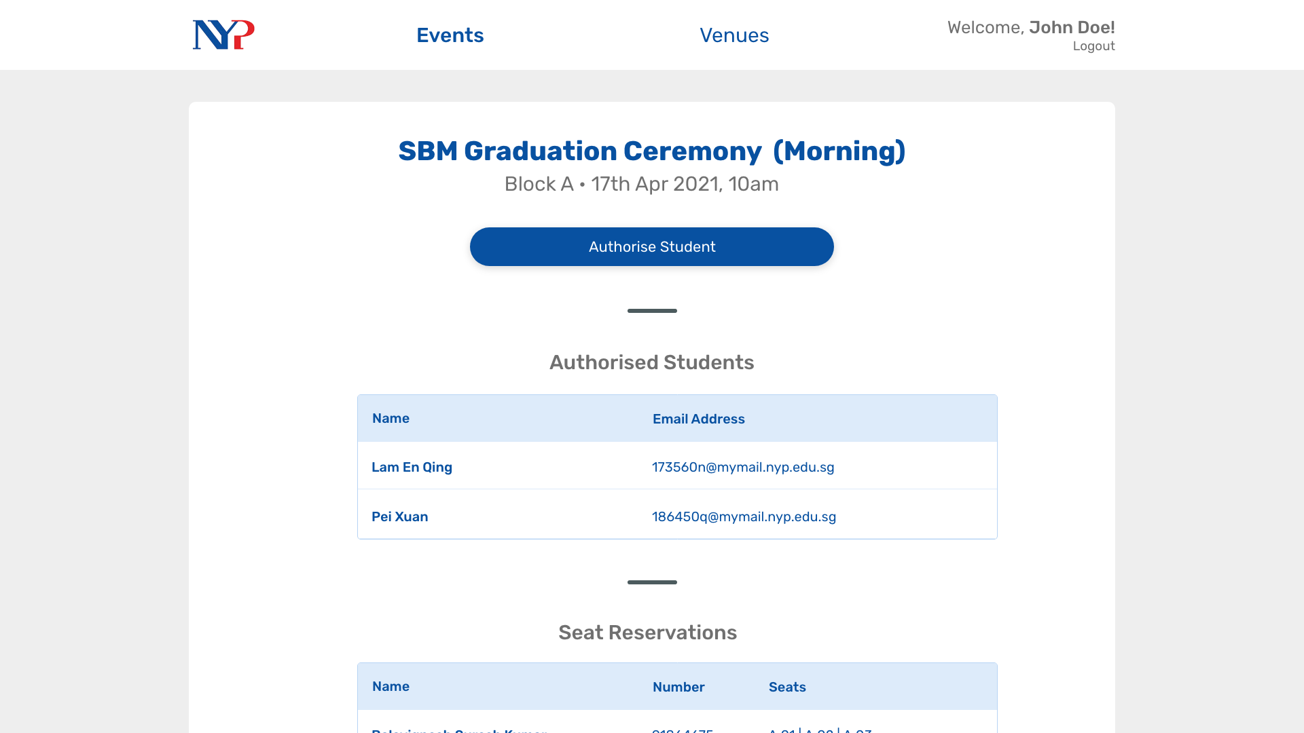

Slide 12
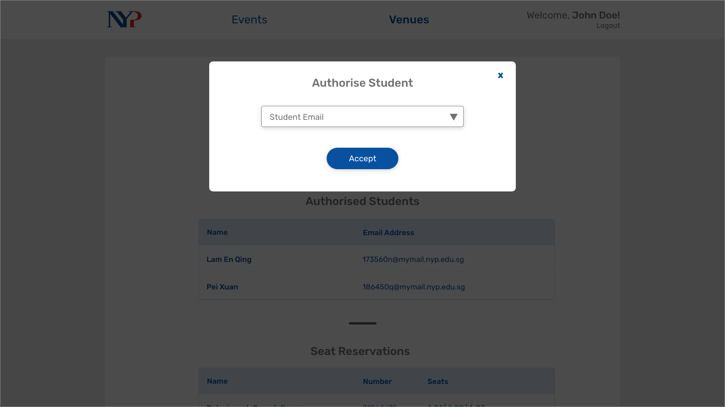

Slide 13
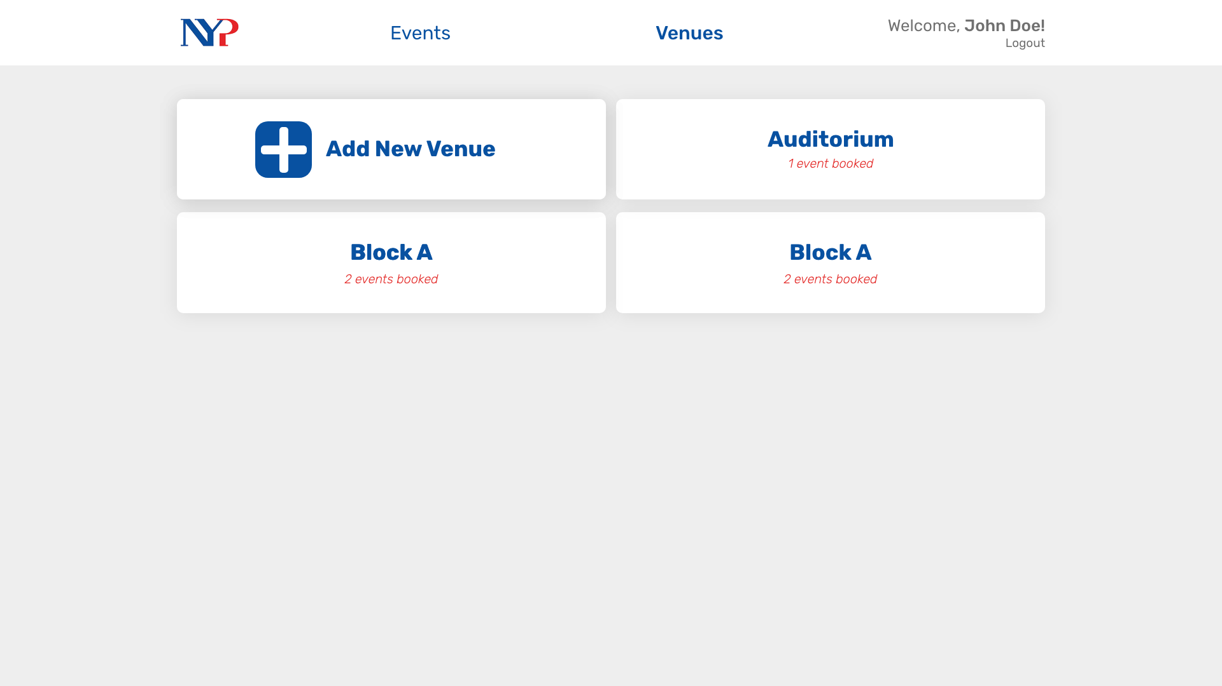

Slide 14
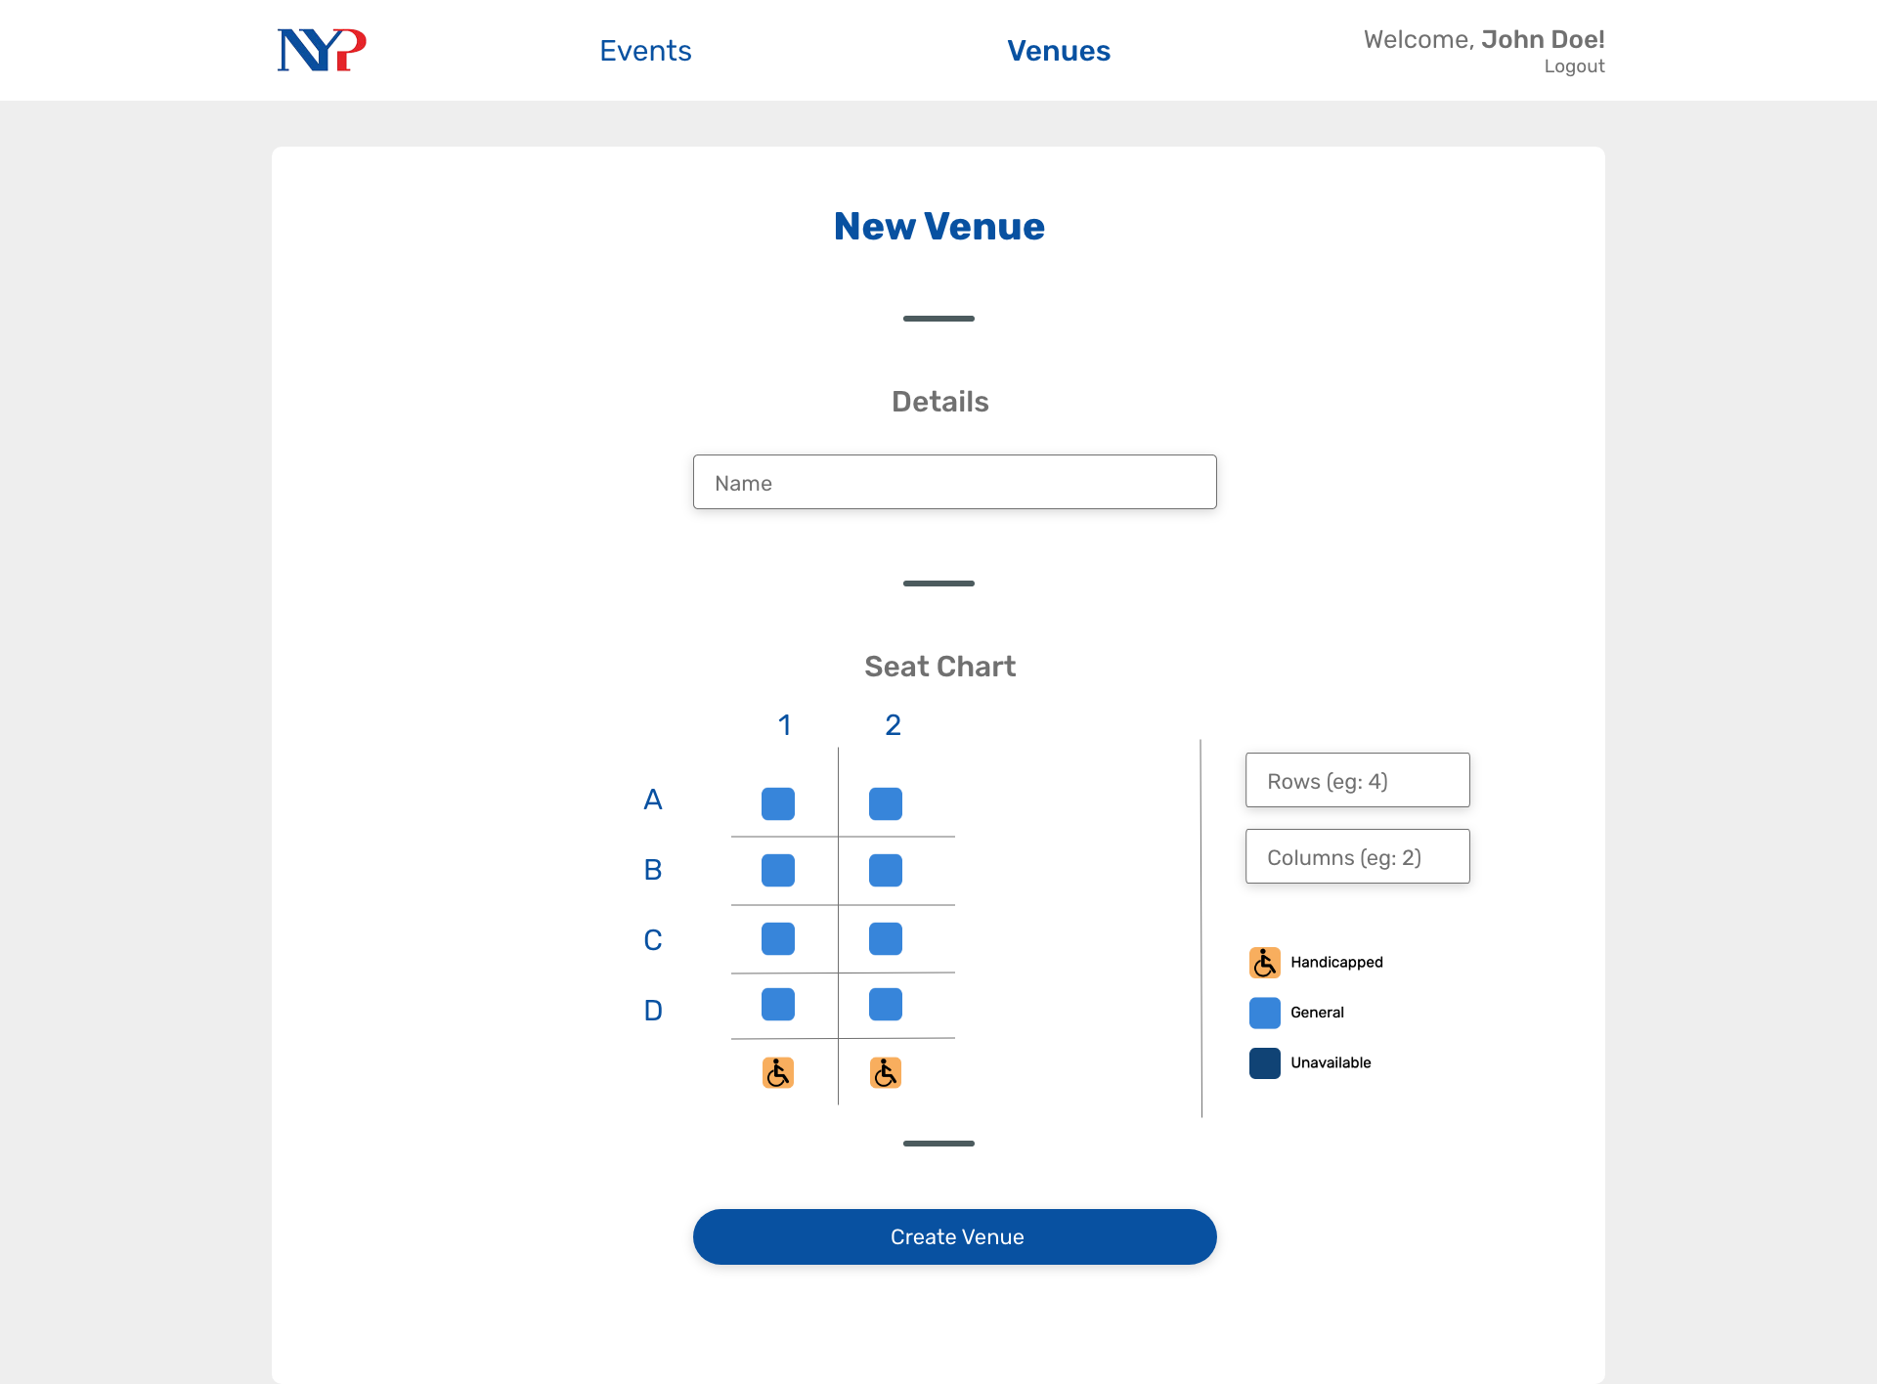

Slide 15
Thank you!

